Slide 1
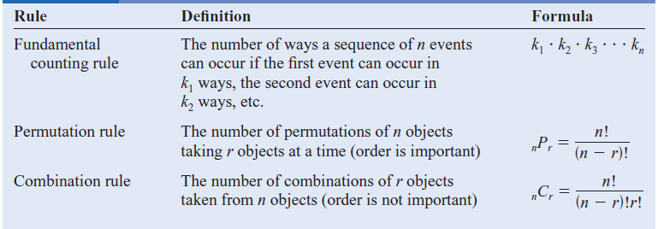
Probability and Counting Rules

Slide 2


Slide 3


Slide 4



Slide 5




Slide 6


Slide 8



Slide 9


